Slide 1
Chapter - 2 Data Modeling Using the Entity– Relationship (ER) Model
Conceptual modeling is a very important phase in designing a successful database application.

Slide 2
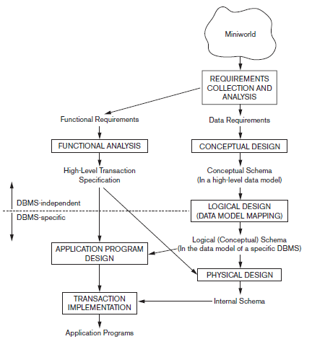
Using High-Level Conceptual Data Models for Database Design
A simplified diagram
to illustrate the main
Phases of Database
Design

Slide 3
The first step is requirements collection and analysis in this step, the database designers interview prospective database users to understand and document their data requirements along with functional requirements of the application, which consist of operations(or transactions). In software design it is common to use data flow, sequence diagrams to specify these requirements.
The second step is to create a conceptual schema for the database, using a high-level conceptual data model. It consists of detailed descriptions of the entity types, relationships, and constraints. These are easier to understand and can be used to communicate with nontechnical users.
The third step in database design is the actual implementation of the database, using a commercial DBMS such as the relational (SQL) model. the conceptual schema is transformed from the high-level data model into the implementation data model. This step is called logical design or data model mapping.
The last step is the physical design phase, during which the internal storage structures, file organizations, indexes, access paths, and physical design parameters for the database files are specified.
In parallel with these activities, application programs are designed and implemented as database transactions corresponding to the high-level transaction specifications.

Slide 4

Entity Types, Entity Sets, Attributes, and Keys
Entity : is an object in the real world with an independent existence. It may have physical existence for example, a particular person, car, house, or employee Or it may have a conceptual existence for instance, a company, a job, or a subject.
Attributes : property or characteristic that describes an entity.
Entity Attributes
Roll No
USN
NAME
SEM
DEPT
DOB

Slide 5
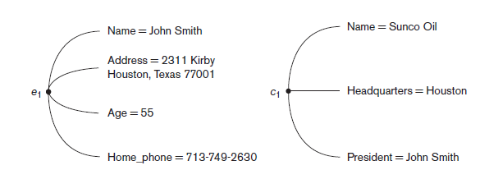
Entities and Attributes:

Slide 6

Title
Author
Publisher
Price
Edition
SUB_CODE
CREDITS
SUBJECT
SNAME
Course_Type

Slide 7
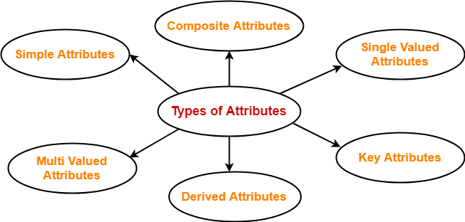
Different Types of Attributes in ER Model

Slide 8
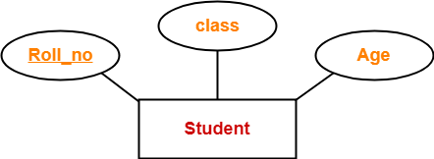
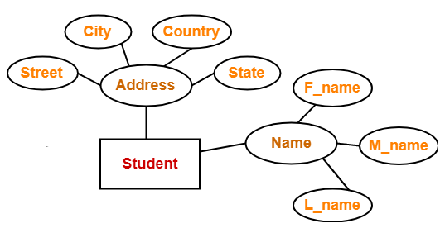
Different Types of Attributes in ER Model
Simple Attribute : Simple attributes are those attributes which can not be divided into sub parts. They are also known as atomic attributes.
Composite Attributes : Composite attributes are those attributes which can divided into smaller sub-parts. The value of a composite attribute is the concatenation of the values of its component simple attributes.

Slide 9
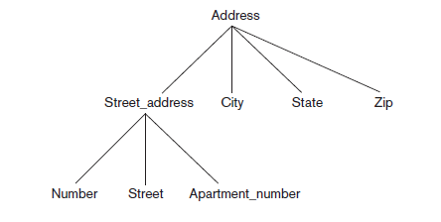
Hierarchy of Composite Attributes:

Slide 10
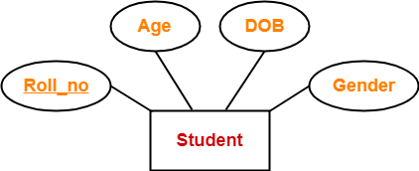
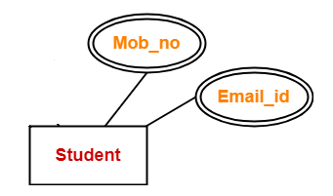
Different Types of Attributes in ER Model
Single Valued : Most attributes have a single value for a particular entity; such attributes are called single-valued.
Multi-Valued : Multi valued attributes are those attributes which can take more than one value for a given entity from an entity set.

Slide 11
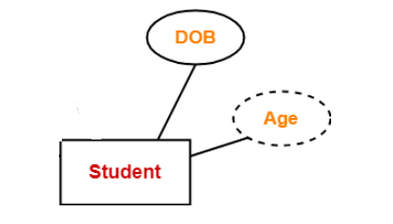
Different Types of Attributes in ER Model
Stored attribute : Stored attributes are the attributes that exist in the physical database.
Derived attribute : Derived attributes are the attributes that do not exist in
the physical database, but their values are derived from other attributes present in the database.
Complex Attributes : is formed by nesting composite attributes and multi-valued attributes in arbitrary way.
For example: A person can have many phone numbers, many e-mail addresses, home addresses etc. So, if there is a attribute in the name of 'Contact detail',it can be a complex attribute.

Slide 12
Complex Attributes
For example,
{Address_phone({Phone(Area_Code, Phone_Number)}, Address(Street_Address(Number, Street, Apartment_Number), City, Zip_Code))}

Slide 13
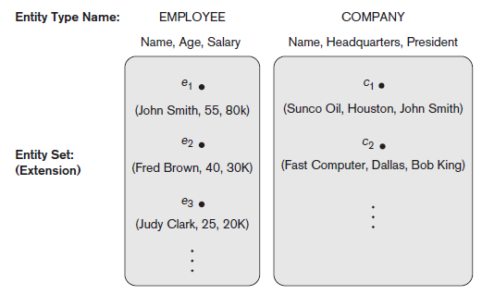
Entity Types, Entity Sets, Keys, and Value Sets
Entity Types : an entity type defines a collection (or set) of entities that have the same attributes. Each entity type in the database is described by its name and attributes.
Entity Sets : The collection of all entities of a particular entity type in the database at any point in time is called an entity set or entity collection; the entity set is usually referred to using the same name as the entity type, even though they are two separate concepts.

Slide 14
STUDENT Entity Type
Entity 1
Entity 2 Entity Set
Entity 3
Entity : It is something which has real existence. Like ROW1 contains information about Ram(id, name and Age) which has existence in real world . So the ROW1 is an entity. So we may say each ROW is an entity.
Entity Type : It is collection of entity having common attribute. As in Student table each row is an entity and have common attributes. So STUDENT is an entity type which contains entities having attributes id, name and Age. Also each entity type in a database is described by a name and a list of attribute. So we may say a table is an entity type.
Entity Set : It is a set of entities of same entity type. so a set of one or more entities of Student Entity type is an Entity Set.
ID | Name | AGE
1 | Ram | 12
2 | Sam | 13
3 | Bheem | 14

Slide 15
ENTITY SET corresponding to the ENTITY TYPE CAR
Entity Type
CAR
Registration(RegistrationNumber, State), VehicleID, Make, Model, Year, (Color)
car₁
((ABC 123, TEXAS), TK629, Ford Mustang, convertible, 1999, (red, black))
car₂
((ABC 123, NEW YORK), WP9872, Nissan 300ZX, 2-door, 2002, (blue))
car₃
((VSY 720, TEXAS), TD729, Buick LeSabre, 4-door, 2003, (white, blue))
.
.
.
Entity Set

Slide 16
Key Attributes : An important constraint on the entities of an entity type is the key or uniqueness constraint on attributes. An entity type usually has one or more attributes whose values are distinct for each individual entity in the entity set. Such an attribute is called a key attribute, and its values can be used to identify each entity uniquely.
Composite key : Some entity types have more than one key attribute.
USN
EID
STUDENT
EMPLOYEE
USN
USN | SUB-CODE | IA 1 | IA 2 | IA 3
1 | 18CS51 | 30 | 40 | 30
1 | 18CS52 | 30 | 40 | 30
1 | 18CS53 | 30 | 40 | 30
IA_MARKS
SUBCODE

Slide 17
Value Sets (Domains) of Attributes
Each simple attribute of an entity type is associated with a value set (or domain of values), which specifies the set of values that may be assigned to that attribute for each individual entity.
Value sets are typically specified using the basic data types.

Slide 18
An Example Database Application
Requirements of the Company (oversimplified for illustrative purposes)
The company is organized into DEPARTMENTs. Each department has a name, number and an employee who manages the department. We keep track of the start date of the department manager. A department may have several locations.
Each department controls a number of PROJECTs. Each project has a name, number and is located at a single location.

Slide 19
Contd…
We store each EMPLOYEE’s social security number, address, salary, and birth date. Each employee works for one department but may work on several projects. We keep track of the number of hours per week that an employee currently works on each project. We also keep track of the direct supervisor of each employee.
Each employee may have a number of DEPENDENTs. For each dependent, we keep track of their name, birth date, and relationship to employee.

Slide 20
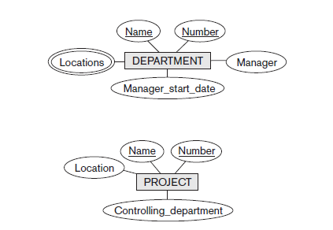
Initial Conceptual Design of COMPANY database:

Slide 21
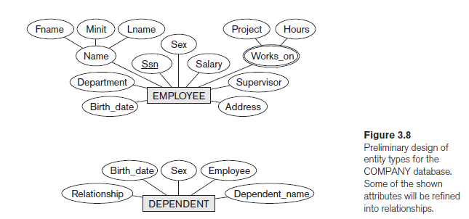

Slide 22
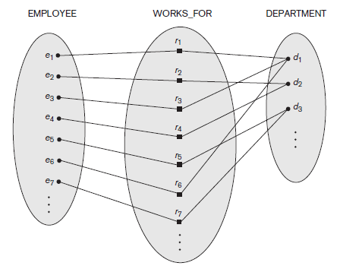
Relationship : an association between entities is called a relationship.
Relationship type : A relationship type R among n entity types E1, E2, . . . , En defines a set of associations— or a relationship set—among entities from these entity types.
Relationship set : Mathematically, the relationship set R is a set of relationship instances ri, where each ri associates n individual entities (e1, e2, . . . , en), and each entity ej in ri is a member of entity set Ej, 1 ≤ j ≤ n.
Works For
Employee
Department
Entity Type
Relationship Type
Relationship Instances or Relationship Set
Entity Set

Slide 23
Degree of a Relationship Type
Degree of a Relationship Type : The degree of a relationship is the number of entity types that participate in the relationship.
Types of Relationships
Unary
Binary
Ternary
N-ary

Slide 24
Unary Relationship Type: A unary relationship is when both participants in the relationship is the same entity.
2. Binary Relationship Type: A binary relationship is when two entities participate, and is the most common relationship degree.
Employee
Supervises
Employee
Works_for
Department

Slide 25
Entities
Relationships
Entities
Doctor
Treats
Patient
Faculty
Heads
Department
Binary Relationship Type
Examples
Student
Studies
Subject
Employee
Manages
Department
Customer
Purchases
Items

Slide 26
Ternary Relationship Type: A ternary relationship is when three entities participate in the relationship.
Teacher
Recommends
Book
Class
Supplier
Supplies
Part
Project

Slide 27
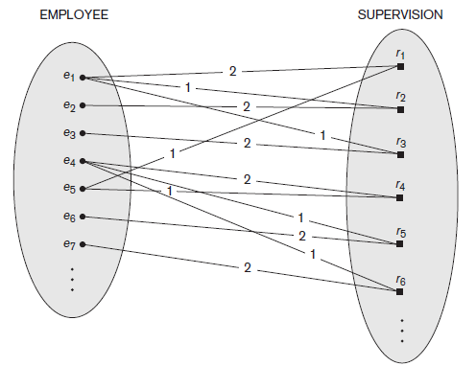
Role Names and Recursive Relationships
Each entity type that participates in a relationship type plays a particular role in the relationship.
For example, in the WORKS_FOR relationship type, EMPLOYEE plays the role of employee or worker and DEPARTMENT plays the role of department or employer.
Same entity type participating more than once in a relationship type in different roles. In such cases the role name becomes essential for distinguishing the meaning of the role that each participating entity plays. Such relationship types are called recursive relationships or self-referencing relationships.
Supervisor
Employee
Supervision
Supervisee

Slide 28
Constraints on Binary Relationship Types
We can distinguish two main types of binary relationship constraints:
Cardinality ratio : The cardinality ratio for a binary relationship specifies the maximum number of relationship instances that an entity can participate in.
These are the different Cardinality ratios,
1:1
1:N
N:1
M:N
Participation Constraint: It specifies the minimum number of relationship instances that each entity can participate in and is sometimes called the minimum cardinality constraint.
There are two types of participation constraints
Total Participation
Partial Participation

Slide 29
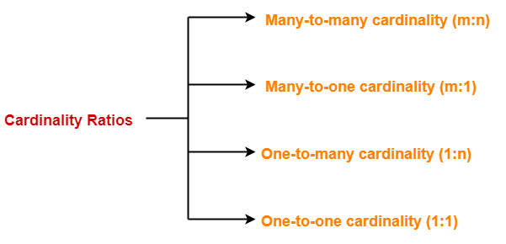
Constraints on Binary Relationship Types : Cardinality ratio
Cardinality ratio: The cardinality ratio for a binary relationship specifies the maximum number of relationship instances that an entity can participate in.
For example, in the WORKS_FOR binary relationship type, DEPARTMENT:EMPLOYEE is of cardinality ratio 1:N, meaning that each department can be related to (that is, employs) any number of employees (N).

Slide 30
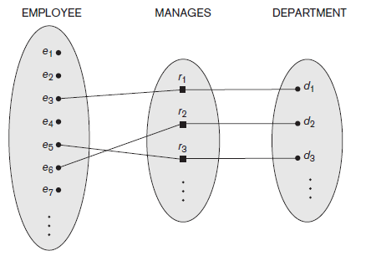
1. One to One Cardinality ratio ( 1 : 1 ) :-
When only one instance of an entity is associated in a relationship with another entity is known as 1 : 1 cardinality ratio.
Both Entities in a binary relationship, participating in zero or maximum of one relationship instance is 1 : 1 cardinality ratio.
1
1
Employee
Heads
Department

Slide 31
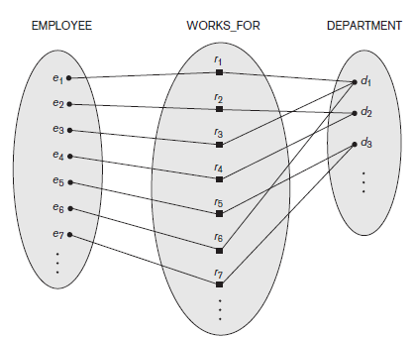
Many to One Cardinality ratio ( N : 1 ) / One to Many Cardinality ratio ( 1 : N )
Either of the two Entities in a binary relationship, One entity participates in more than one relationship instances, and another entity participates in only one relationship instance is 1 : N or N : 1 cardinality ratio.
1
N
Department
Has
Faculty
N
1
Student
Has
Department

Slide 32
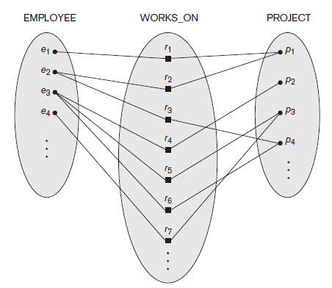
3. Many to Many Cardinality ratio ( M : N ) :-
Both Entities in a binary relationship, participating in more than one relationship instances M : N cardinality ratio.
Student
M
N
Subjects
Studies
Employee
M
N
Project
Works_On

Slide 33
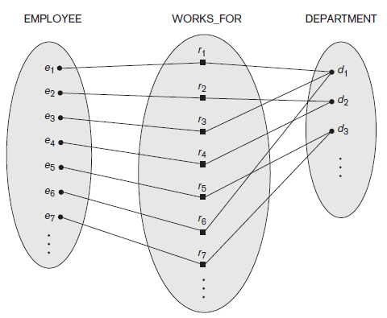
Participation Constraints and Existence Dependencies
The participation constraint specifies whether the existence of an entity depends on its being related to another entity via the relationship type. This constraint specifies the minimum number of relationship instances that each entity can participate in and is sometimes called the minimum cardinality constraint.
Total Participation Constraint : also known as existence dependence, every entity should participate in at least one relationship instance for its existence.
Partial Participation Constraint : an entity may or may not participate in any relationship instance(s)

Slide 34
Total Participation is represented by double line in ER Model
Partial Participation is represented by single line in ER Model
Every employee is not expected/eligible to manage a department, so the participation of EMPLOYEE in the MANAGES relationship type is partial, meaning that some or part of the set of employee entities are related to some department entity via MANAGES, but not
necessarily all.
Thus, the participation of EMPLOYEE in WORKS_FOR is called total participation, meaning that every entity in the total set of employee entities must be related to a department entity via WORKS_FOR.
(0,1)
(1,1)
Employee
Manages
Department
1
1
(1,1)
(1,N)
Employee
Works_for
Department
N
1

Slide 35


Attributes of Relationship Types
Relationship types can also have attributes, similar to those of entity types.
Start
Date
Employee
1
Manages
1
Department
Start
Date
Employee
Works_for
Department
N
1
No Of Hours
Employee
M
Works_on
N
Project

Slide 36
Employee
Department
Project
EID | EName | AGE | Salary | Start_Date
1 | Ram | 28 | 35000 | 01-08-2018
2 | Sam | 29 | 45000 | 01-08-2016
3 | Bheem | 30 | 30000 | 01-08-2018
DID | Dname | Intake | Dhead | Start_Date
1 | CS | 120 | Dr. A | 01-08-2018
2 | ME | 120 | Dr. B | 01-08-2016
3 | EC | 120 | Dr. C | 01-08-2018
PID | Pname | Plocation
1 | X | BGM
2 | Y | BGLR
3 | Z | DELHI

Slide 37
Weak Entity Types
Entity types that do not have key attributes of their own are called weak entity types.
They are identified by being related to specific entities from another entity type in combination with one of their attribute values. We call this other entity type the identifying or owner entity type and we call the relationship type that relates a weak entity type to its owner the identifying relationship of the weak entity type.
In ER diagrams, both a weak entity type and its identifying relationship are distinguished by surrounding their boxes and diamonds with double lines. The partial key attribute is underlined with a dashed or dotted line.

Slide 38
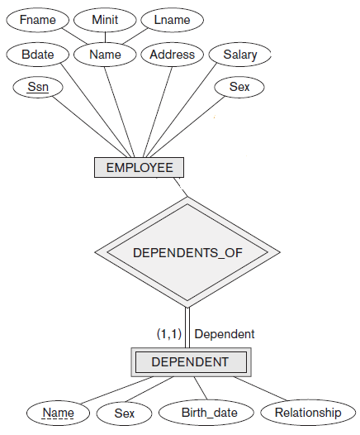

Slide 39
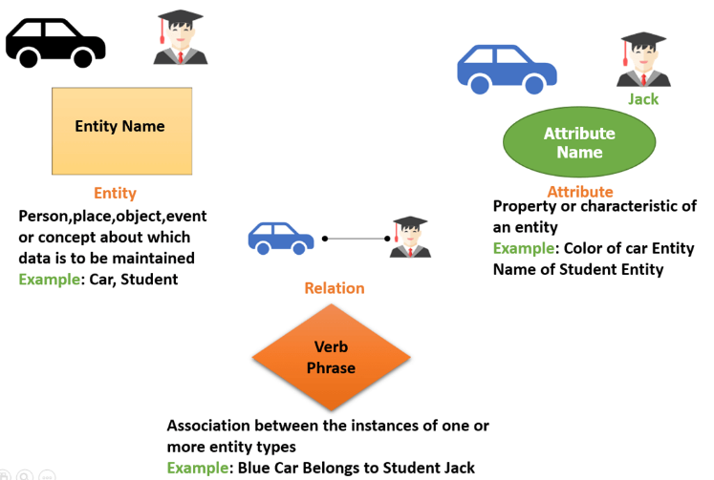
Recall

Slide 40
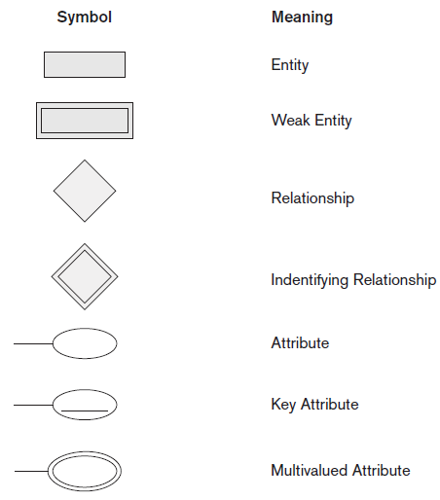
Symbols Used
In
ER Diagram

Slide 41
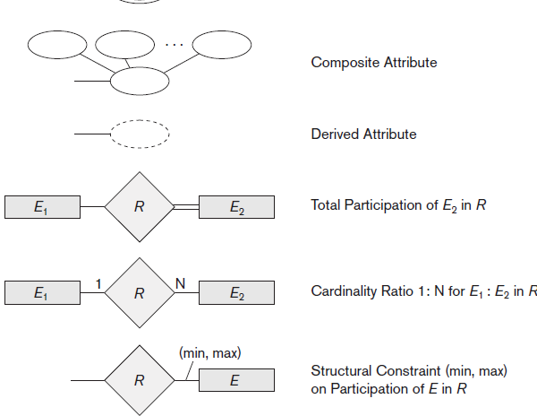

Slide 42
Steps Involved in Drawing an ER Diagram
Identify the Entities
Identify the Relationship among the entities
Identify Various Attributes of each entity
Identify key Attributes
Identify Cardinality ratio
Represent Participation Constraints

Slide 43
An Example Database Application
Requirements of the Company
The company is organized into DEPARTMENTs. Each department has a name, number and an employee who manages the department. We keep track of the start date of the department manager. A department may have several locations.
Each department controls a number of PROJECTs. Each project has a name, number and is located at a single location.

Slide 44
Contd…
We store each EMPLOYEE’s social security number, address, salary, sex, and birth date. Each employee works for one department but may work on several projects. We keep track of the number of hours per week that an employee currently works on each project. We also keep track of the direct supervisor of each employee.
Each employee may have a number of DEPENDENTs. For each dependent, we keep track of their name, sex, birth date, and relationship to employee.

Slide 45
Draw ER Diagram for a Company Database
Scenario :
Tata Steels Private Limited wants to have a database application to store all the information generated in the company.
The company has many 5 Departments in it, each Department has many Employees working in it. Each Department has a manager, there can be only one manager for a Department. Every Employee should work for one or the other Department. Each Department controls many Projects. An employee works in more than one Project. Each Employee has Dependents. Every Employee is supervised by one or the other supervisor. A Department can control minimum of 1 and maximum of 5 projects.

Slide 46
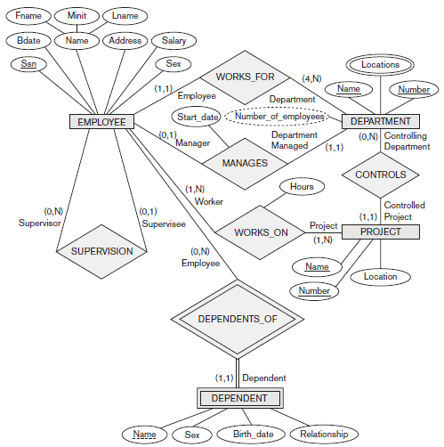

Slide 47
Draw ER Diagram for a Movie Database
Scenario :
Sony Pictures Motion Picture Group wants to have a database application to store all the information generated in the company.
Sony Pictures Produces many Movies every year. Each Movie is contributed by various people like Actors, Producers, Directors, Choreographers, Screenplay Writers, etc involved in it. There can more than one actor/actress in each Movie. Each movie is rated by various rating agencies. A Movie can be any language.

Slide 48
Draw ER Diagram for a Hospital Database
Scenario :
KLE Hospital wants to have a database application to store all the information generated in the hospital.
KLE Hospital wants to maintain each and every information that is generated in the hospital which includes Employees (Doctors, Lab Technicians, Nurses, Security Personnel, Administrators etc), Patients, Departments. There are many doctors who treat many patients. Each Doctor belongs to a particular department depending on his/her expertise. There are many departments in the hospital. Each department has a head. Nurses work for a particular department to serve the patients. Each department has a pharmacy, operation rooms, patient rooms (private, semi-private, general).

Slide 49
Draw ER Diagram for a Train Reservation System
Scenario :
Indian Railways wants to have a database application to store all the records for data analysis.
There are many Trains in Indian Railways, each train has details like Train No, Train Name, Source, Destination and No of SL, AC1,AC2,AC3 seats. Each train is driven by Driver. Customer can book train seats after registration into the Indian Railways by giving basic details. Customer can book any number of seats from any source to destination on the availability of the seats. There are different types of seats Sleeper class, Ac Tier1, Ac Tier2, Ac Tier3. All the Seat Booking information should be maintained properly.
Consider the following details for Drawing ER Diagram,
Entities: TRAIN, DRIVER, BOOKING_INFO, CUSTOMER_INFO, TRAIN_FARES
Relationships : Drives, Fares_from_each_src_to_Dest, Books_Seat, Seat_Enquiries

Slide 50
ER DIAGRAMS

Slide 51
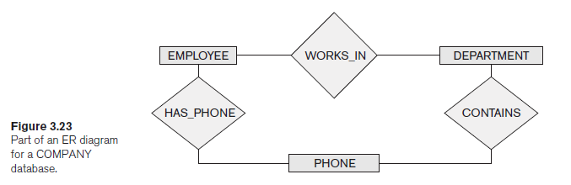

Slide 52
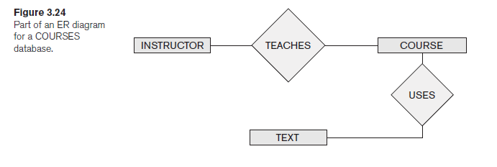

Slide 53
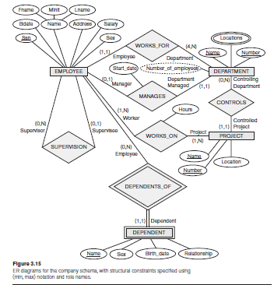
Company Schema

Slide 54
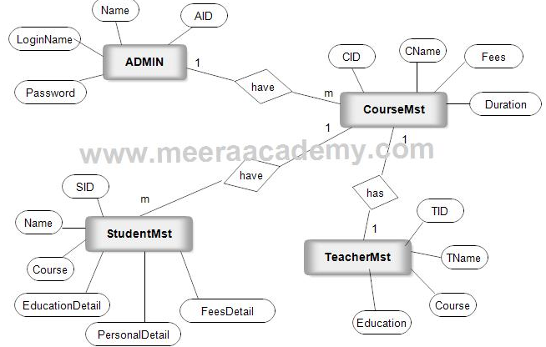

Slide 55
Institute Database
Design an ER-Model for an educational institute which is required to record the student’s attendance and IA performance in all the subjects and inform the same to their parents. The institute will have many departments, each with its own faculty and Head of the department. The subjects the student’s study can be either elective or core. A faculty has to take at least one subject and at most 2 subjects and the subjects are not shared. The students take 3 tests and the average is computed by taking average of best two of the three scores. The model be designed to record only the CIE marks and not SEE marks. After the ER-Model, map it to relational schema by identifying Primary and Foreign keys.

Slide 56
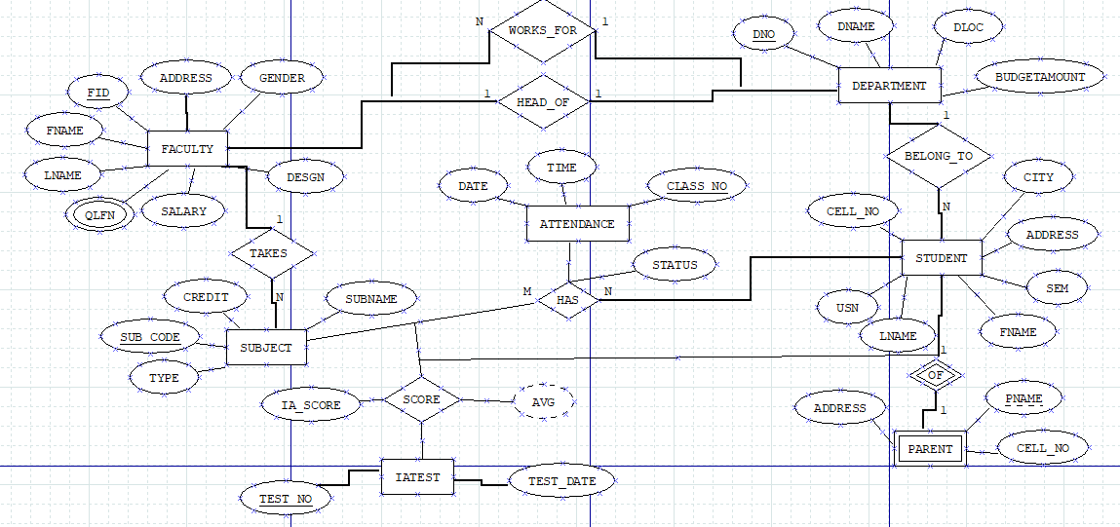

Slide 57
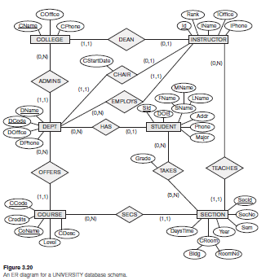
University database schema

Slide 58
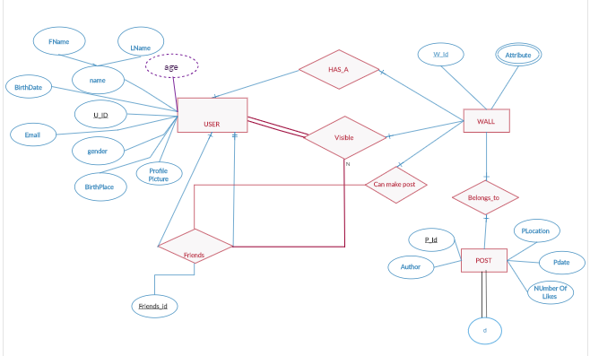
Facebook Database

Slide 59
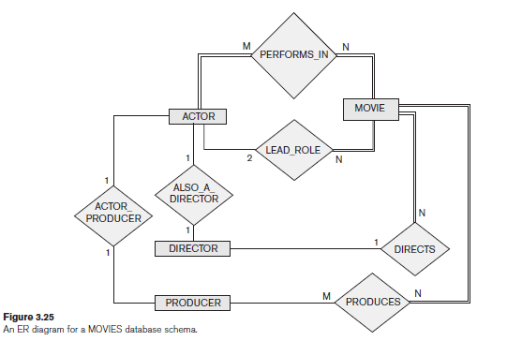
Movies database schema

Slide 60
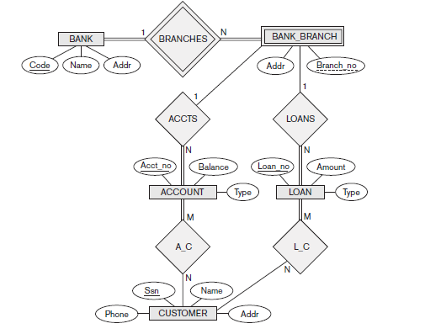
Bank database schema

Slide 61
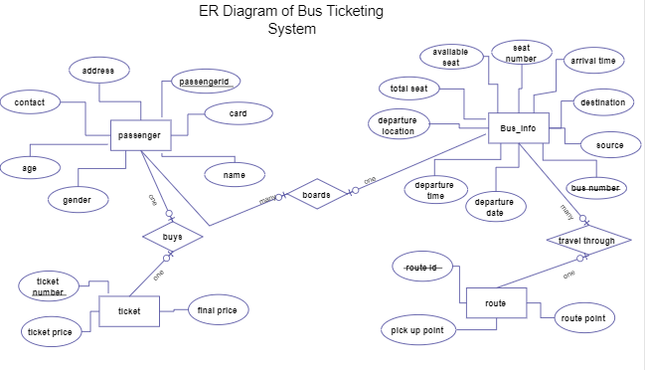
Bus Ticketing System

Slide 62
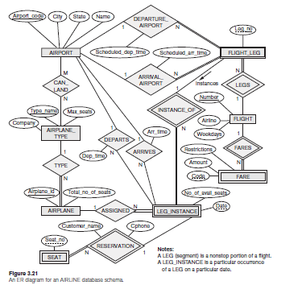
Airline database schema

Slide 63
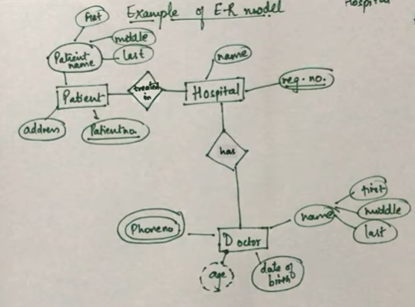
Hospital Management System

Slide 64
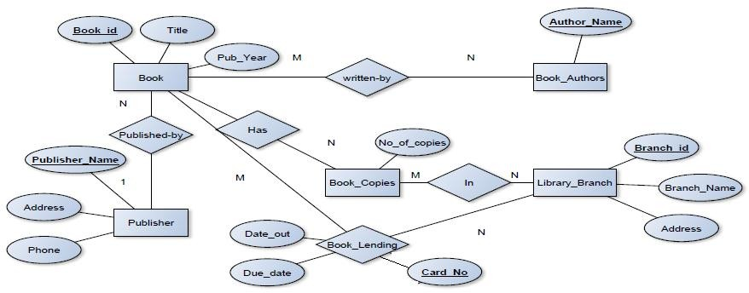
Library Database:

Slide 65
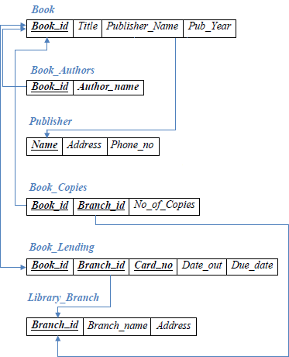

Slide 66
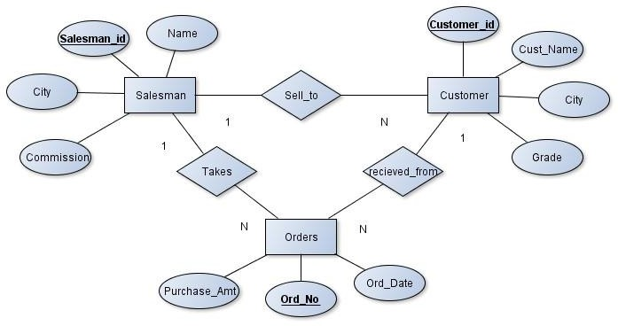
ORDER DATABASE

Slide 67
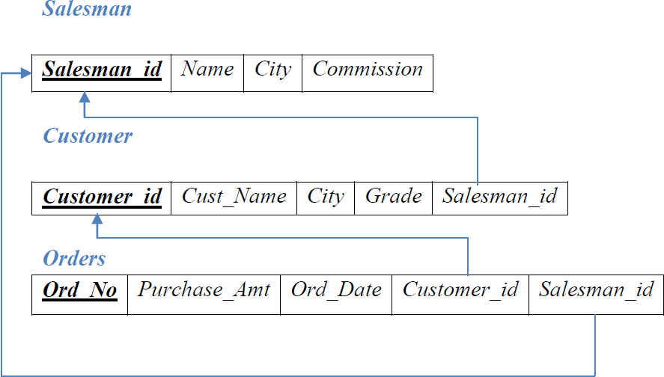

Slide 68
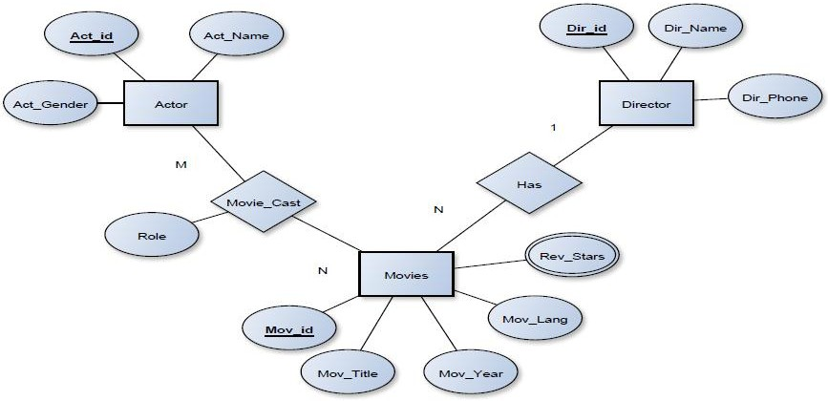
MOVIE DATABASE

Slide 69
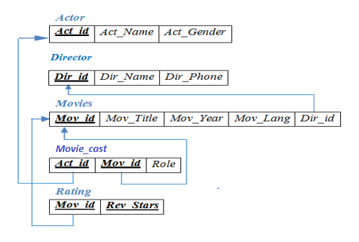

Slide 70
National Hockey League (NHL)
Suppose you are given the following requirements for a simple database for the National Hockey League (NHL):
the NHL has many teams,
each team has a name, a city, a coach, a captain, and a set of players,
each player belongs to only one team,
each player has a name, a position (such as left wing or goalie), a skill level, and a set of injury records,
a team captain is also a player,
a game is played between two teams (referred to as host_team and guest_team) and has a date (such as May 11th, 1999) and a score (such as 4 to 2).

Slide 71
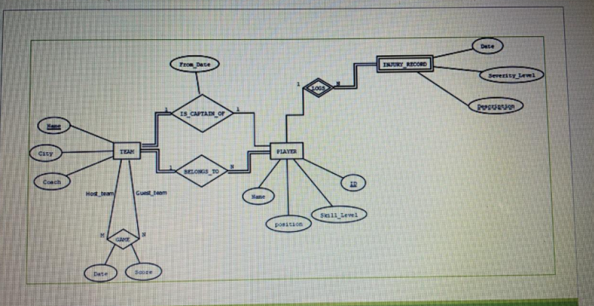
NHL

Slide 72
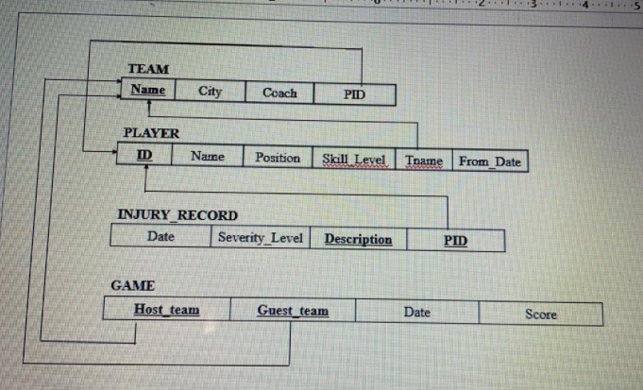

Slide 73
Cab Management System
The latest cab services agency in the city has approached you to develop a Cab Management System for them. They would be using this software to efficiently manage and track different cabs that are operated by them.
Cabs are solely owned by the agency. They hire people in contracts to drive the cabs. A cab can be uniquely identified by, like any other vehicle in the country, its license plate. A few different categories of cars are available from different manufacturers. And a few of them are AC cars.
Cab drivers are given an identification card while joining. The ID card contains his name, permanent address, phone number, and date of joining, duration of contract. Also, a unique alphanumeric code is assigned to each number.
The agency provides service from 8 AM to 8 PM. whenever any passenger books a cab, an available cab is allocated for him. The booking receipt given to the passenger contains the car #, source and destination places. Once he reaches the destination, he signs on a duplicate copy of the receipt and gives back to the driver. Driver must submit this duplicate copy signed by the passenger at the agency for confirmation.
To evaluate their quality of service, the agency also wants a (optional) customer satisfaction survey, where passengers can provide feedback about their journey through the agency's website.

Slide 74
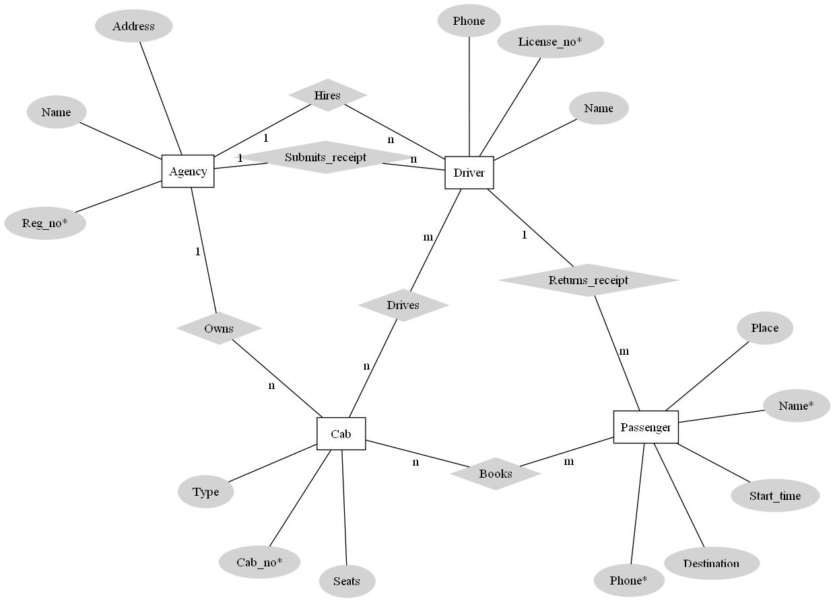

Slide 75
Suppose that you are a database designer and you have been approached to design a database for CAR INSURANCE COMPANY. Design an ER diagram according to the requirements mentioned below:
a. The company keep track of customer information like id, name, address and phone.
b. Company stores the details of cars like registration number, engine number, model, price, colour etc that is owned by customers.
c. Company records accidents (if any) that each car has made using the attributes like accident identifier, location, time and date of accident.
d. Company also maintains the license information of customers i.e., license number, issue date and expiry date.
e. Mention the appropriate participation constraints and cardinality ratios.

Slide 76
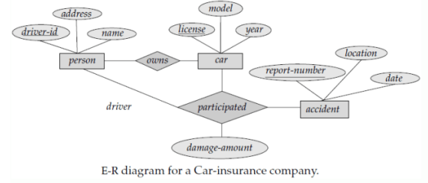

Slide 77
Relational Database Design by ER-to-Relational Mapping
Copyright © 2007 Ramez Elmasri and Shamkant B. Navathe
Notes:
77

Slide 78
ER-To-Relational Mapping
In Database Management Systems, ER stands for Entity-Relationship. ER modelling help to figure out the set of entities, attributes of each entitiy, and the relationship that is shared between entities. In other words it helps us to explain the logical structure of databases.

Slide 79
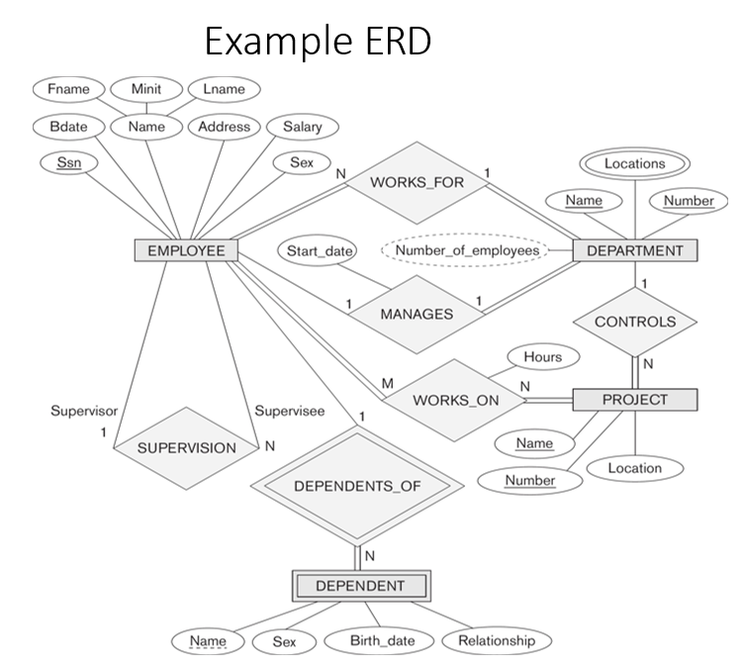
ER-Diagram for a Company Database

Slide 80
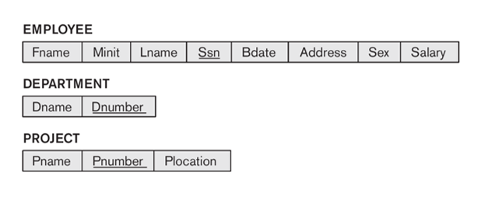
Step 1: Mapping of Regular Entity Types
1.Figure out all the regular/strong entity from the diagram and then create a corresponding relation(table) that includes all the simple attributes.
2. Choose one of the attributes as a primary key. If composite, the simple attributes together form the primary key.
3. For the given ER-Diagram we have Employee, Department and Project as strong/regular entity, as they are enclosed in single rectangle.
4. So, we create respective relations that is depicted in the figure below.

Slide 81
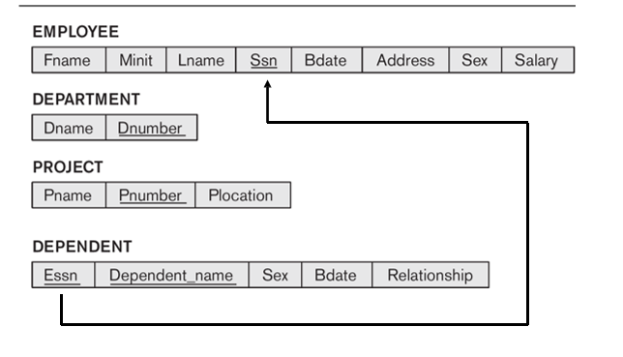
Step 2:Mapping of Weak Entity Types
1. Figure out the weak entity types from the diagram and create a corresponding relation(table) that includes all its simple attributes.
2. Add as foreign key all of the primary key attributes in the entity corresponding to the owner entity.
3. The primary key is a combination of all the primary key attributes from the owner and the primary key of the weak entity.
4. For the given ER-Diagram we have Dependent as a weak entity, as it is enclosed in a double rectangle that is indicative of an entity being weak.
5. The Dependent relation(table) is created that is shown in the figure below.

Slide 82
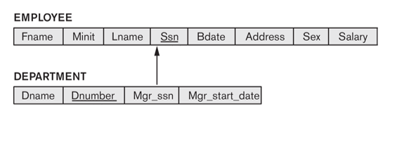
Step 3:Mapping of Binary 1:1 Relation Types
1. Now we need to figure out the entities from ER diagram for which there exists a 1-to-1 relationship.
2. The entities for which there exists a 1-to-1 relationship, choose one relation(table) as S, the other as T. Better if S has total participation (reduces the number of NULL values).
3. Then we need to add to S all the simple attributes of the relationship if there exists any.
4. After that, we add as a foreign key in S the primary key attributes of T.
5. For the given ER-Diagram there exists a 1-to-1 relationship between Employee and Department entity.
6. Here Department has total participation therefore consider it as relation S and Employee as relation T.
7. The 1-to-1 mapping between Employee and Department is depicted in the figure below.

Slide 83

Step 4: Mapping of Binary 1:N Relationship Types
1. Now we need to figure out the entities from ER diagram for which there exists a 1-to-N relationship.
2. The entities for which there exists a 1-to-N relationship, choose a relation as S as the type at N-side of relationship and other as T.
3. Then we add as a foreign key to S all of the primary key attributes of T.
4. In the given ER diagram there are two 1-to-N relationships that exists between Employee-Department and Employee-Dependent entity.
5. The 1-to-N mapping between Employee-Department and Employee-Dependent is depicted in the figure below.

Slide 84

Step 5: Mapping of Binary M:N Relationship Types
1. Now we need to figure out the entities from ER diagram for which there exists an M-to-N relationship.
2. Create a new relation(table) S.
3. The primary keys of relations(tables) between which M-to-N relationship exists, are added to the new relation S created, that acts as a foreign key.
4. Then we,add any simple attributes of the M-to-N relationship to S.
5. For the given ER-Diagram there exists M-to-N relationship between Employee and Project entity.
6. The new table Works_On is created for mapping the relationship between Employee and Project relation(table).

Slide 85

Step 6: Mapping of Multivalued attributes
1. Now identify the relations(tables) that contain multi-valued attributes.
2. Then we need to create a new relation S
3. In the new relation S we add as foreign keys the primary keys of the corresponding relation.
4. Then we add the multi-valued attribute to S; the combination of all attributes in S forms the primary key.
5. For the given ER-Diagram there exists a multi-valued attribute (Locations) in Department relation(table).
6. So, we create a new relation called Dept_Locations. To this new relation we add the primary key of Department Table that is D_Number and the multi-valued attribute Locations.

Slide 86


Step 7: Mapping of N-ary Relationship Types
For each n-ary relationship type R, where n>2, create a new relationship S to represent R.
Include as foreign key attributes in S the primary keys of the relations that represent the participating entity types.
Also include any simple attributes of the n-ary relationship type (or simple components of composite attributes) as attributes of S.
Example: The relationship type SUPPLY
This can be mapped to the relation SUPPLY shown in the relational schema, whose primary key is the combination of the three foreign keys {SNAME, PARTNO, PROJNAME}
Slide 7- 86
Notes:
86

Slide 87

FIGURE : Result of mapping the COMPANY ER schema into a relational schema.
Slide 7- 87
Notes:
87

Slide 88

Figure below shows an ER schema for a database that can be used to keep track of Student and their reading habits. Deduce this ER diagram into a relational schema and specify all primary keys and foreign keys.

Slide 89


Slide 90
Institute Database

Slide 91


Slide 92
Summary
ER-to-Relational Mapping Algorithm
Step 1: Mapping of Regular Entity Types
Step 2: Mapping of Weak Entity Types
Step 3: Mapping of Binary 1:1 Relation Types
Step 4: Mapping of Binary 1:N Relationship Types.
Step 5: Mapping of Binary M:N Relationship Types.
Step 6: Mapping of Multivalued attributes.
Step 7: Mapping of N-ary Relationship Types.
Slide 7- 92
Notes:
92

